Slide 1
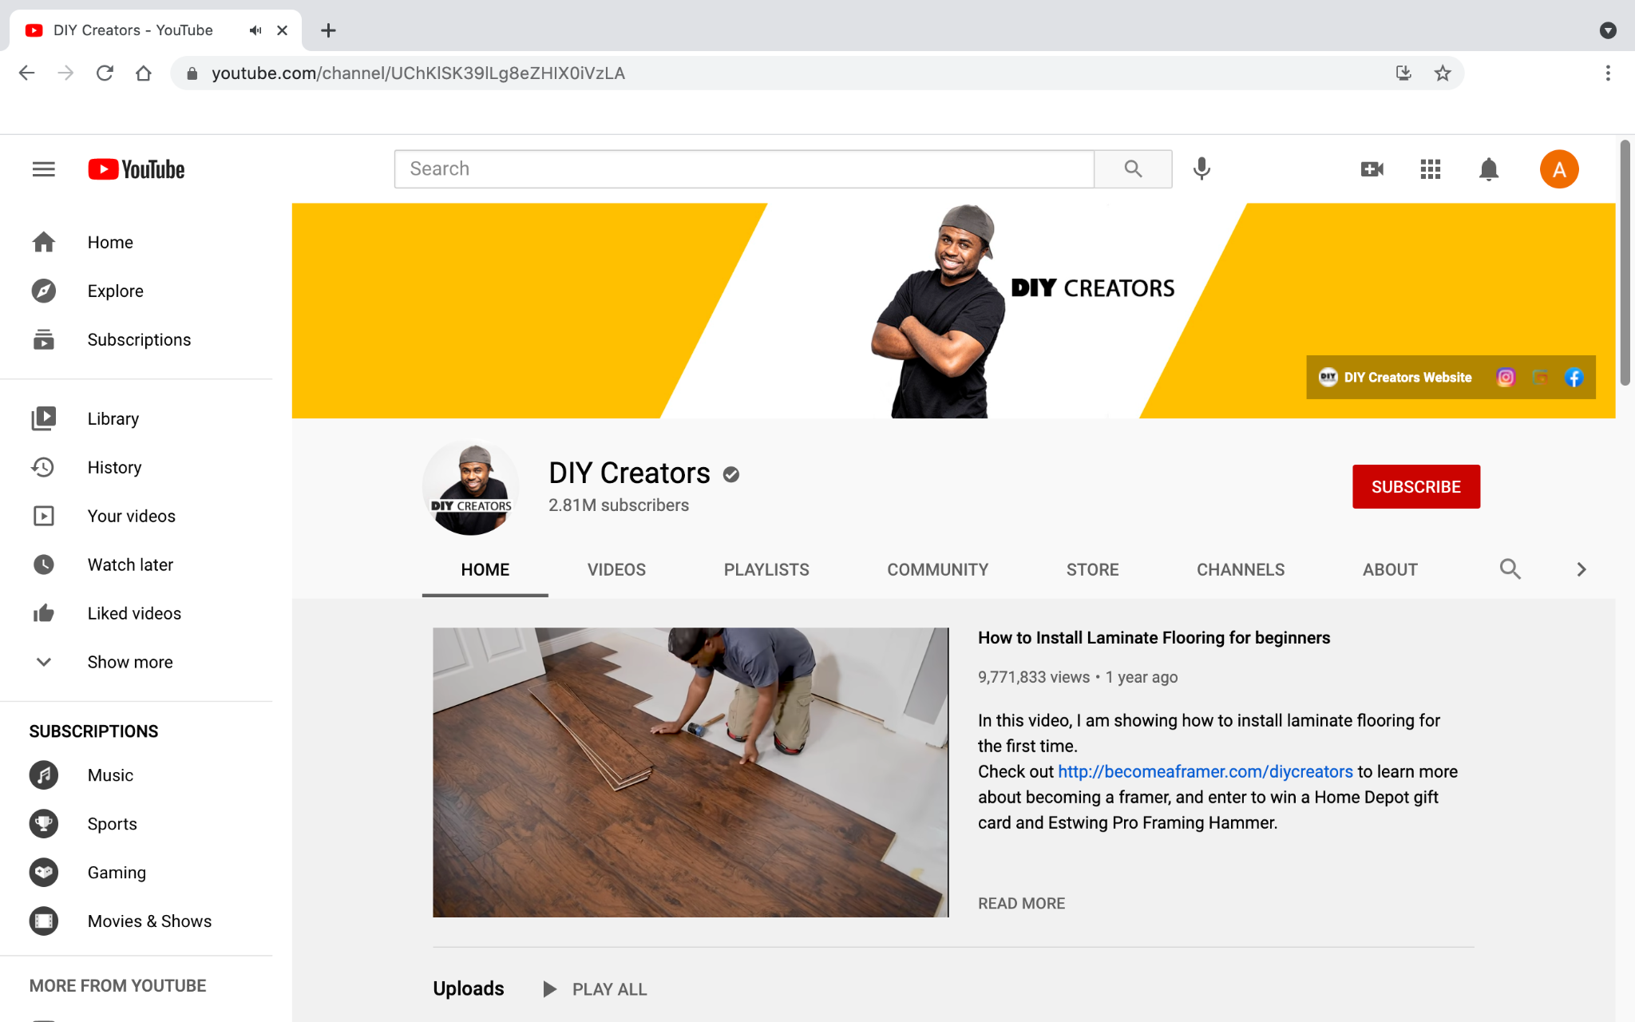
Use YouTube To Grow Your Business
Every day, millions of people come to YouTube and watch over a billion hours of video. They come to be informed, inspired, or just plain delighted. You can use YouTube to build your brand by connecting your message with engaged watchers.
Banner image
Profile picture
Video spotlight
1
2
3
People watch
When people want to know how to do something, they often turn to YouTube first.
People discover
68% of YouTube users watched the channel to help make a purchase decision.
Google/Ipsos Connect, U.S., YouTube Cross Screen Survey, July 2016.
People engage
People watch videos. Use that focused interest to grow your business with YouTube.

Slide 2
How to create a channel
How to upload a video
1.
2.
3.
4.
5.
Visit YouTube.com and sign into your account.
Click “Create account,” choose “For myself” or “To manage my business.”
Click the circle at the top right. This reveals a drop down menu. From here, click “Create a channel.”
Click “Select” under “Use a custom name” and enter a name for your new channel.
Follow the prompts, which guide you through the steps to customize your channel.
1.
2.
3.
4.
5.
Click “Create” in the upper left, next to your brand’s account pic.
From the drop down menu, choose “Upload videos.”
Once you upload the video, enter all of the information on the details screen.
Choose video visibility: private, unlisted, or public. Publish now or schedule for later.
Learn how people engage with your videos by reviewing video analytics.
Additional Resources
Advertise on YouTube
youtube.com/ads
Explore advertising options on YouTube.
Stream with YouTube Live
studio.youtube.com
Reach & interact with people in real time.
Creator Academy
creatoracademy.youtube.com
Grow your channel with free online courses.
For additional resources check out google.com/grow and g.co/GrowOnAir

