Slide 1
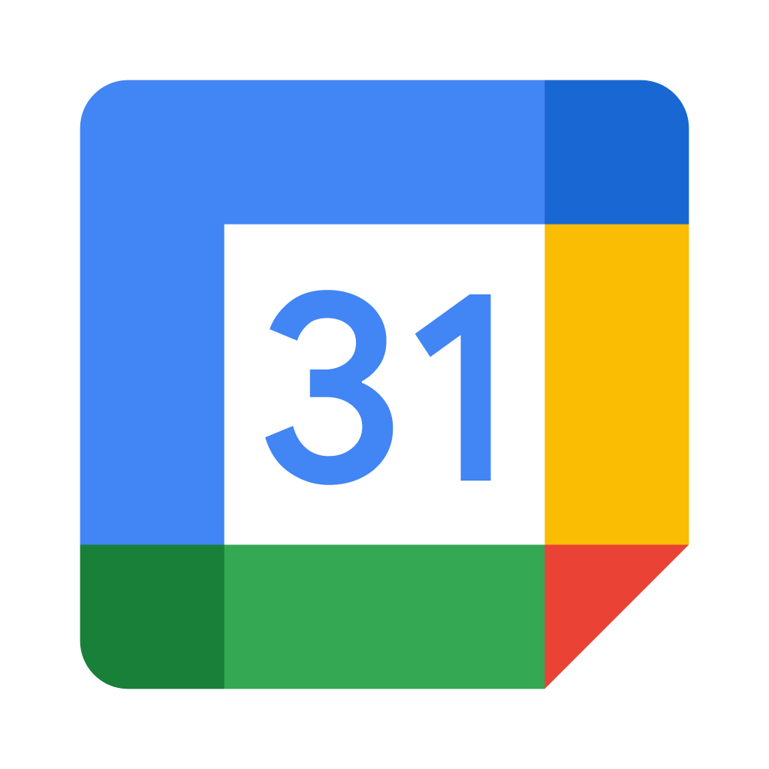
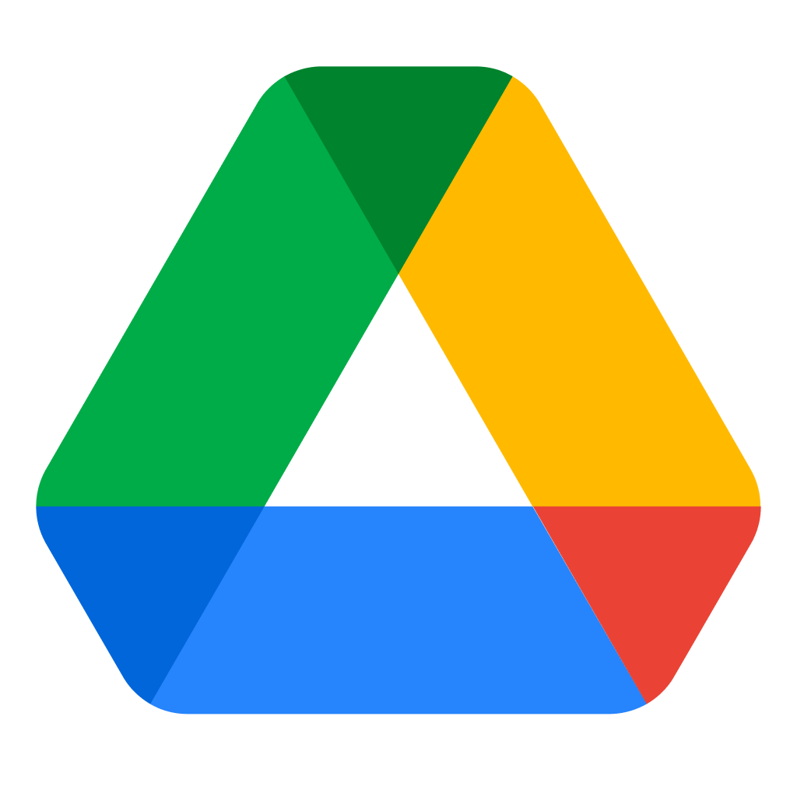
Collaborate, Meet,
and Work Remotely
Many communities are navigating this time of uncertainty, and need
online tools to remain productive. To help, we’ve gathered some of
Google’s resources so you can work and collaborate from home.
Google Meet
lets you have a video conference call, from anywhere. Use Meet to schedule client meetings, host online classes, and keep in touch with your team.
meet.google.com
Google Calendar
creates shareable calendars that integrate seamlessly with Gmail, Drive, Meet, and more. View and edit your schedule from your computer, phone, or tablet.
calendar.google.com
Google Drive
allows you to access your
documents and files from any device. You can securely store and share files with your team and collaborate in real time.
drive.google.com

Slide 2
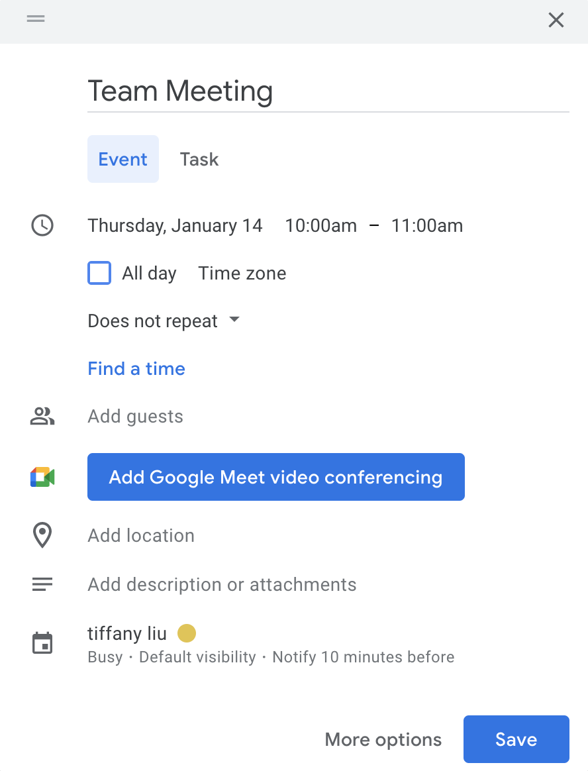
How to Start a Google Meet Video Call From Google Calendar
1.
2.
3.
4.
5.
Go to calendar.google.com
Click Create in the top left
Add event details, day, and time. Click the Add Google Meet video conferencing button.
Guests will receive an invitation via email; they can join the meeting by clicking Join with Google Meet
You can start the meeting by navigating to the event on your calendar and clicking Join with Google Meet. Or you can visit meet.google.com and start it from there
Additional Resources
Google Career Certificates
grow.google/certificates
Prepare for a new career in six months or less with professional training designed by Google. Learn at your own pace and get a certificate to help you stand out to employers.
YouTube Channel
YouTube.com/GrowWithGoogle
Subscribe to the Grow with Google YouTube Channel for expert tips to grow your skills, career, or business.
For additional resources, check out google.com/grow

