Slide 1
Managing Innovation and Risk in Today’s Cybersecurity Environment
Diana L. Burley, PhD
Professor, Human & Organizational Learning
Executive Director, Institute for Information Infrastructure Protection
The George Washington University
dburley@gwu.edu | 202-994-5835
USPAACC CEO Academy – 7 September 2018

Slide 2
“Go out on a limb. That's where the fruit is.”
Jimmy Carter

Slide 3
Navigating VUCA Environments
Perpetual optimism is a force multiplier.” -Colin Powell

Slide 4
Volatile Uncertain Complex Ambiguous Environments
Immigration
Technology innovation
Competition
Political climate
Domestic/Global terrorism
Workforce shortages
GDPR
Brexit
Artificial Intelligence
Health care law
Cyber crime
Automation
Gig economy
Global Trade
Adversaries
Machine Learning
Trade wars
Crypto currency
IoT
Climate change
Ransomware
Global cyber policy

Slide 5
Volatile Uncertain Complex Ambiguous Environments lead to …
Poor decision-making
Unnecessary risks
Workforce turnover
Damaged culture
Competitive losses
…

Slide 6
Volatile
Unstable; unpredictable change
Uncertain
Unreliable; lacking certainty of outcome
Complex
Multiple, inter-dependencies
Ambiguous
Unfamiliar; lacking clear meaning

Slide 7
Volatile
Unstable; unpredictable change
Uncertain
Unreliable; lacking certainty of outcome
Complex
Multiple, inter-dependencies
Ambiguous
Unfamiliar; lacking clear meaning
How much do you know?
How well can you predict the outcome?
Why is the innovation necessary?
What are you willing to risk?

Slide 8
How do you find the right balance between innovation and risk?

Slide 9
Innovation Portfolio

Slide 10
Innovation Portfolio
Breakthrough
Innovation
Incremental/Sustaining
Innovation
Well Defined
Problem
Basic
Research/Architectural
Innovation
Disruptive/Radical
Innovation
Not Well Defined
Not Well Defined
Well Defined
Domain

Slide 11
Changes or improves an existing product, service, or process that has a significant impact on the business or creates a new market
Improves, enables or sustains an existing product, service, or process
Breakthrough
Innovation
Incremental/Sustaining
Innovation
Well Defined
Problem
Basic
Research/Architectural
Innovation
Disruptive/Radical
Innovation
Not Well Defined
New products, services or processes that enter at the bottom of the market, move up over time and displace established market leading products, services, or processes.
New business processes/models or applying the lessons, skills and overall technology to a different/new market.
Not Well Defined
Well Defined
Domain

Slide 12
What is your innovation portfolio?
Breakthrough
Innovation
Incremental/Sustaining
Innovation
Well Defined
Problem
Not Well Defined
Basic
Research/Architectural
Innovation
Disruptive/Radical
Innovation
Not Well Defined
Well Defined
Domain

Slide 13
Organizational values shape the boundaries of Acceptable Risk

Slide 14
Benefit/Regret Matrix
High
Benefit
Low
Low
High
Regret

Slide 15
Determining Acceptable Risk
High
Benefit
Low
Is the project aligned with our values?
Benefit
How does the project contribute to our strategy?
What is the project’s expected financial return?
Regret
What is the likelihood of a ‘negative’ outcome?
What is the impact of a ‘negative’ outcome?
Low
High
Regret
Use both qualitative and quantitative assessments.

Slide 16
“Test fast, fail fast, adjust fast.” – Tom Peters
High
Benefit
Low
Low
High
Regret

Slide 17
“You can’t steal second base and keep your foot on first.” – Frederick Wilcox
High
Benefit
Low
Low
High
Regret

Slide 18
“Don't be afraid to take a big step. You can't cross a chasm in two small jumps.” – David Lloyd George
High
Benefit
Low
Low
High
Regret

Slide 19
High
Benefit
Low
Low
High
Regret
“Take calculated risks. That is quite different from being rash.” – General George Patton

Slide 20
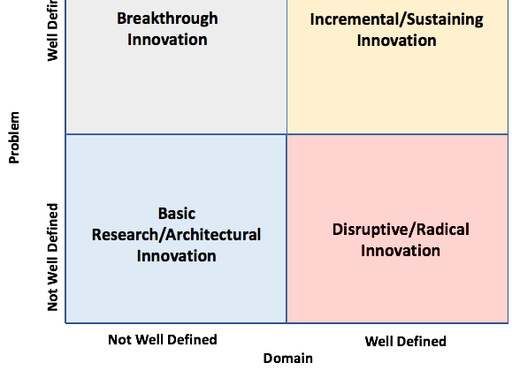
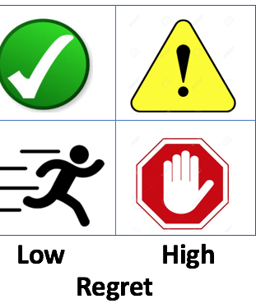
Control, manage and measure risk in the context of your innovation portfolio

Slide 21
Mine Your Data
Look for hidden value
Prioritize
Use advanced analytics
Encourage agility
Analyze scenarios

Slide 22
Support a Culture of Collaboration
Expand the frontier of knowledge through social networks
Develop shared understanding through communities of practice
Gain wisdom through peer crowd-sourcing
Encourage open internal dialogue about risks and intelligent mistakes

Slide 23
LEAD

Slide 24
Encouraging Innovation in a VUCA environment
Volatile
Uncertain
Complex
Ambiguous
Vision
Mission, values, strategy
Understanding
Know internal capability
Clarity or Courage
Seek knowledge / Embrace risks
Adaptability
Flexibility, agility, contingency, speed

Slide 25
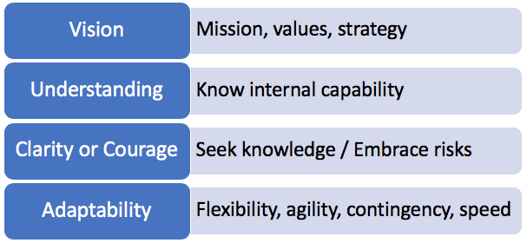
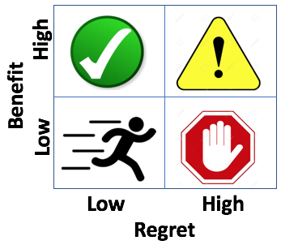
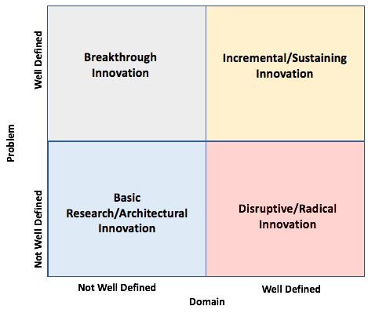
“Perpetual optimism is a force multiplier.” -Colin Powell

Slide 26
Discussion

Slide 27
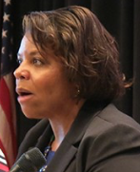
Diana L. Burley, Ph.D. is executive director and chair of the Institute for Information Infrastructure Protection (I3P) and professor of human and organizational learning at the George Washington University. She regularly advises global public and private sector organizations on cybersecurity strategy, policy, and workforce development initiatives. Dr. Burley has testified before the US Congress, conducted international cybersecurity training, and written nearly 100 publications; including the 2014 book “Enterprise Software Security: A Confluence of Disciplines.” She recently led an international task force that published the first set of global cybersecurity curricular guidelines. Prior to GW, Dr. Burley led the Cyber Corps™ program and managed a multi-million-dollar computer science education and research portfolio for the US National Science Foundation. She is a member of the US National Academies Board on Human-Systems Integration, the RANE expert network, and several industry advisory boards. In 2017, SC Magazine recognized her as one of 8 Women in IT Security to Watch and awarded her with their leadership award in IT Security Education. Other recent honors include: 2016 Woman of Influence by the Executive Women’s Forum in Information Security, Risk Management and Privacy; 2014 Cybersecurity Educator of the Year; and 2014 Top Ten Influencer in information security careers. Dr. Burley earned her doctorate and 2 master’s degrees from Carnegie Mellon University where she studied as a Woodrow Wilson Foundation Fellow in public policy and management.
Contact Dr. Burley to discuss strategic consulting, executive education, keynote appearances, or other opportunities:
E: dburley@gwu.edu T: 202-994-5835

