Slide 1
NAVIGATE YOUR FUTURE WITH A DIGITAL MAP
Jeremiah Owyang
Industry Analyst and Founding Partner
July 2019 | @jowyang

Slide 2
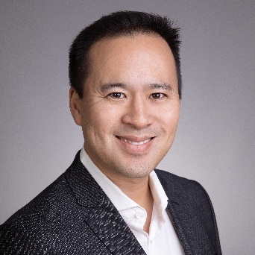
About me.
Jeremiah Owyang
Silicon Valley.
Entrepreneur. Industry Analyst.
Family. Fitness. Founder.
Chinese Heritage

Slide 3
1. What’s the goal?
Notes:
Photos from pexels
https://www.pexels.com/photo/three-person-holding-smartphones-1061579/
https://www.pexels.com/photo/light-smartphone-macbook-mockup-67112/
https://www.pexels.com/photo/apple-applications-apps-cell-phone-607812/

Slide 5
2. Fish where the fish are
Notes:
Photos from pexels
https://www.pexels.com/photo/three-person-holding-smartphones-1061579/
https://www.pexels.com/photo/light-smartphone-macbook-mockup-67112/
https://www.pexels.com/photo/apple-applications-apps-cell-phone-607812/

Slide 6
3. Meaningful content, draw people in
Notes:
Photos from pexels
https://www.pexels.com/photo/three-person-holding-smartphones-1061579/
https://www.pexels.com/photo/light-smartphone-macbook-mockup-67112/
https://www.pexels.com/photo/apple-applications-apps-cell-phone-607812/

Slide 7
Notes:
Photo: https://www.satellitetoday.com/innovation/2019/04/24/satellite-iot-for-5g-whats-the-story/

Slide 8
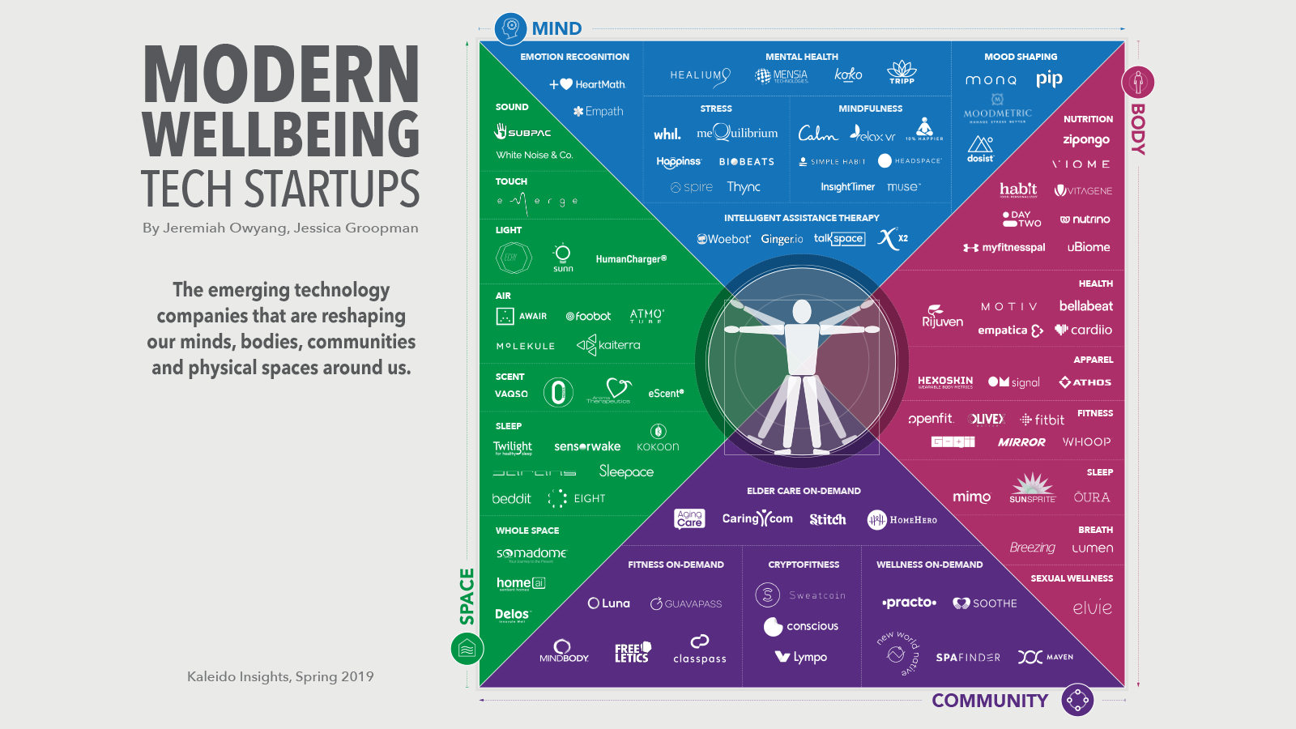
Notes:
IN every phase, simple technologies create a POWER shift.

Slide 9
4. Promote, it’s about advertising now
Notes:
Photos from pexels
https://www.pexels.com/photo/three-person-holding-smartphones-1061579/
https://www.pexels.com/photo/light-smartphone-macbook-mockup-67112/
https://www.pexels.com/photo/apple-applications-apps-cell-phone-607812/

Slide 10
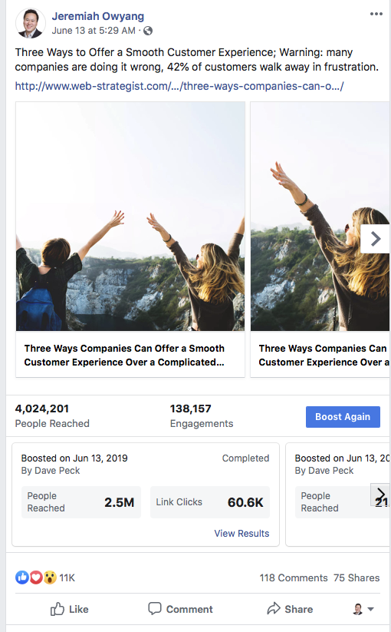
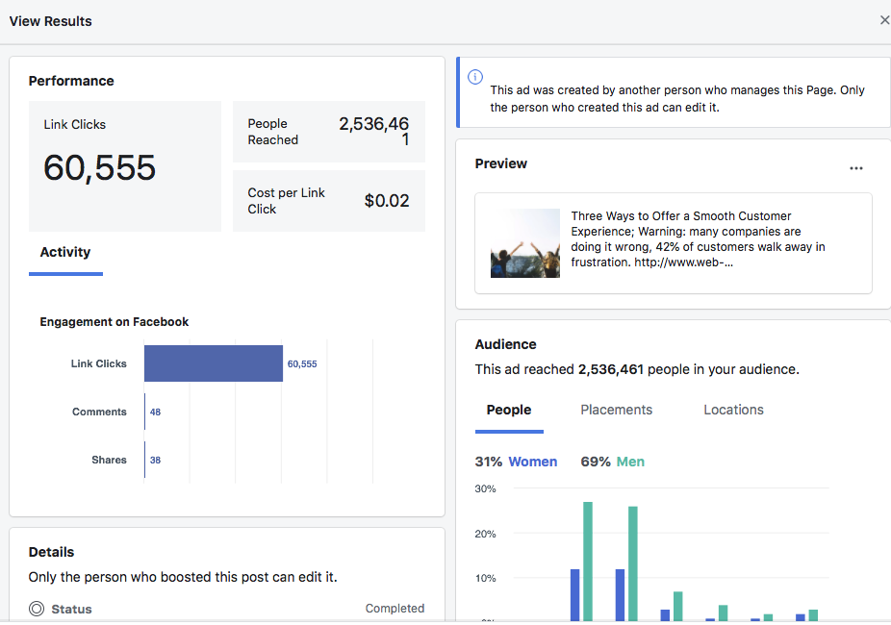
Notes:
Photos from pexels
https://www.pexels.com/photo/three-person-holding-smartphones-1061579/
https://www.pexels.com/photo/light-smartphone-macbook-mockup-67112/
https://www.pexels.com/photo/apple-applications-apps-cell-phone-607812/

Slide 11
5. Series of content. Strategy “The Thanksgiving Turkey”
Notes:
Photos from pexels
https://www.pexels.com/photo/three-person-holding-smartphones-1061579/
https://www.pexels.com/photo/light-smartphone-macbook-mockup-67112/
https://www.pexels.com/photo/apple-applications-apps-cell-phone-607812/

Slide 12
6. Ask they want they
want to hear
Notes:
Photos from pexels
https://www.pexels.com/photo/three-person-holding-smartphones-1061579/
https://www.pexels.com/photo/light-smartphone-macbook-mockup-67112/
https://www.pexels.com/photo/apple-applications-apps-cell-phone-607812/

Slide 13
7. Content Calendar
Notes:
Photos from pexels
https://www.pexels.com/photo/three-person-holding-smartphones-1061579/
https://www.pexels.com/photo/light-smartphone-macbook-mockup-67112/
https://www.pexels.com/photo/apple-applications-apps-cell-phone-607812/

Slide 14
Team
Notes:
https://techcrunch.com/2017/01/10/check-out-the-real-world-version-of-the-mercedes-benz-drone-delivery-van/
Mercedes-Benz and drone startup Matternet unveiled their concept ‘Vision Van’ at CES 2017. .. complete with drones nested up on the roof, and a working intelligent front LED display.
In back of the van is an inventory storage rack with a path down the middle that looks very much like what you’d expect to see in a standard inventory warehouse. The racks are designed to slide out as a complete array, so that the vans can be stocked quickly just by swapping out the entire interior in one go. A robot arm in the van that packs the drones via a slot in the roof is programmed with the package locations on each inventory rack before the van starts making its rounds.

Slide 15
8. Incorporate with your physical interactions
Notes:
Photos from pexels
https://www.pexels.com/photo/three-person-holding-smartphones-1061579/
https://www.pexels.com/photo/light-smartphone-macbook-mockup-67112/
https://www.pexels.com/photo/apple-applications-apps-cell-phone-607812/

Slide 16
9. Engage!
Notes:
Photos from pexels
https://www.pexels.com/photo/three-person-holding-smartphones-1061579/
https://www.pexels.com/photo/light-smartphone-macbook-mockup-67112/
https://www.pexels.com/photo/apple-applications-apps-cell-phone-607812/

Slide 17
10. Measure with business goals --not just with social media engagement metrics
Notes:
Photos from pexels
https://www.pexels.com/photo/three-person-holding-smartphones-1061579/
https://www.pexels.com/photo/light-smartphone-macbook-mockup-67112/
https://www.pexels.com/photo/apple-applications-apps-cell-phone-607812/

Slide 18
THANK YOU!
Jeremiah Owyang
Analyst and Founding Partner
jeremiah@kaleidoinsights.com

