Slide 1
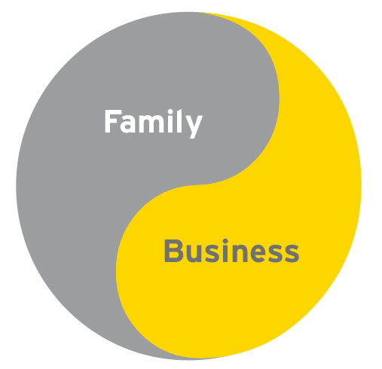
The Challenges of Working in a Family Business
Presented by
Kirby Wu, AIA, LEED AP
Wu & Associates – construction since 1990

Slide 2
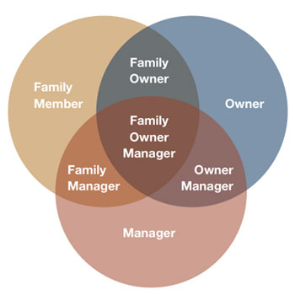
Internal dynamics between family members
External perceptions of staff members
Differences in management style
Decision making challenges
Balancing family goals vs. business goals
Succession planning

Slide 3
It’s a mixed bag
The upsides
The downsides
Working as a family team
Building wealth and keeping it within the family
Providing opportunities to family members
Potential for high level of trust
Not being able to work cooperatively
Deciding what’s fair in the wealth sharing amongst family members
Taking on risk for the entire family
Letting go of non-optimal performers
Separating personal goals from work goals

Slide 4
Family dynamics
Must be able to communicate in a fashion that leaves out personal relationships.
“Business is Business.”
Can one family member take instructions from another family member?
There must be a final decision maker. Avoid every decision to be by the entire “committee” or family members.
Subordinate family members must also respect that there is a hierarchy, e.g. spouses that are at a equal level at the home now must take orders and instructions from the other spouse.
If there are multiple family members involved, how do you treat each of them fairly?

Slide 5
External perceptions
With the exception of the founder, many from the outside may view family members as having their roles solely due to nepotism.
It is hard for younger family members to find their own identity and not be lost in the shadow of the family business.
Others may view that the family member is not “making it on their own,” or has been “given the silver spoon.”
Can staff give constructive feedback to family members without fearing for their jobs?

Slide 6
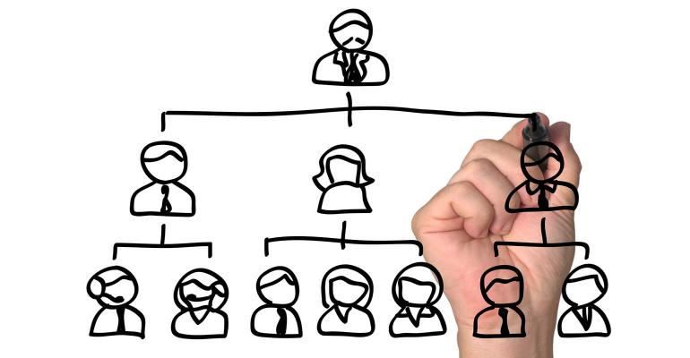
Management style
Different generations will have different management styles, such as
How to delegate to others
How to handle human resource issues
What personality type is most effective, e.g. ‘Type A’ authoritative versus more of a communicative manager

Slide 7
Decision making
Again, must maintain a clear hierarchy.
Roles and expectations must be clearly laid out, e.g. job descriptions.
There may not be unanimous agreement on every decision; however, a decision must always be made.

Slide 8
Goals
For a family business to grow, family members must be able to trust and delegate to non-family members.
To keep other staff happy and willing to stay in the business, there must be fair opportunity for all to grow within the company.
Founders must acknowledge the roles and contributions of all family.

Slide 9
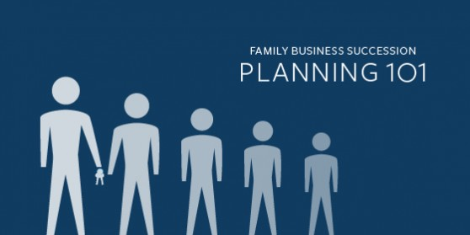
Succession planning
It is never too early to talk about succession planning.
Options after founder retires:
1. Sell the business. To outside party or within. Keep the business moving forward
2. Give the business to family.
3. Dissolve the business.
Have an understanding of the Federal / State estate planning laws to maximize asset transfer.
Have an estate planning attorney.

