Slide 1
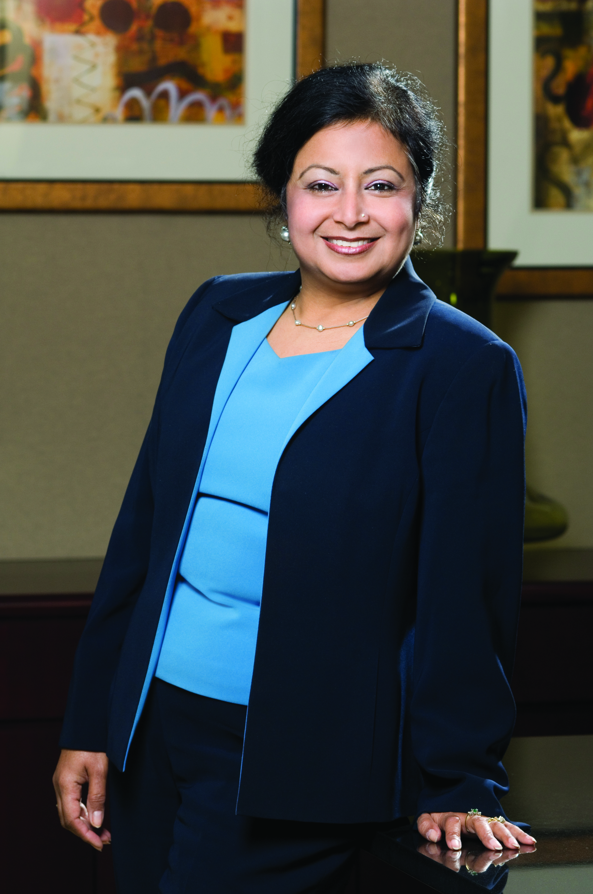
“Leading with a
Passion for Success”
Neera Bahl,
Esquire
President of
USPAACC-Southeast
December 15, 2016

Slide 2
“Leading with a Passion for Success”
. . . . And an Entrepreneurial Spirit
In 2005, Neera began practicing law and became a partner with Dixit, Youn and Bahl. Prior to her law practice, Neera served as a law clerk with the Superior Court of Fulton County and notably as an intern at the Carter Center of Justice.
In 2008, she started her own private law practice,
Neera Bahl & Associates Law Firm, and gained
much prominence in the field of immigration law.
For the past three years, Neera has served as the President of USPAACC-SE, a regional affiliate of USPAACC National located in Atlanta, GA.
Neera has achieved great success leading
Asian Americans business firms to certify, develop, partner and connect with Corporate America.

Slide 3
Our Success Stories . . .
The 2016 Welcome to Atlanta
“Southern Hospitality” Reception & Gathering
in conjunction with CelebrAsian 2016
USPAACC-SE made history by winning its pitch to cost-host the USPAACC 2016 Procurement Conference and to bring it to the South for the first time ever!
With all votes in – the decision was for Atlanta and USPAACC-SE !
We are Positioned to Deliver New & Exhilarating Programs!

Slide 4
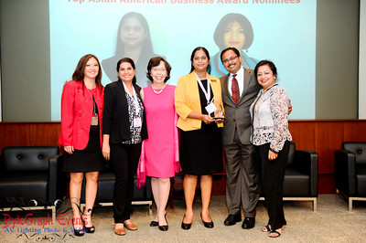
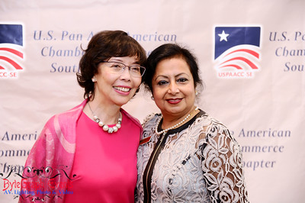
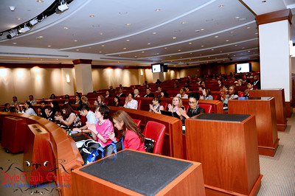
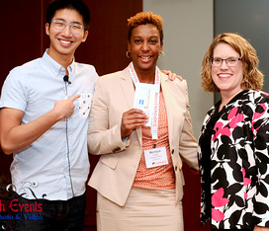
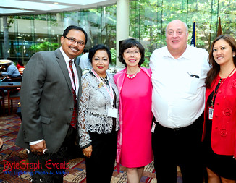
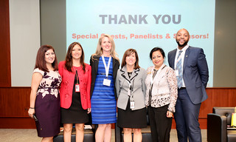
Our Success Stories . . .
2015 & 2016 Annual Business Summit &
Top Asian American Business Awards
Each year USPAACC-SE brings the most phenomenal leaders, speakers, businesses and partners together for power-packed engagements at our Annual Summit.
Increasing Our Reach with Engaging Signature Events!

Slide 5
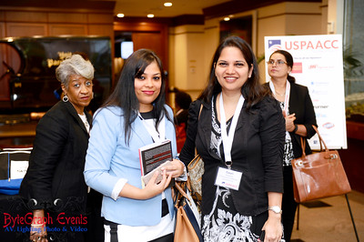
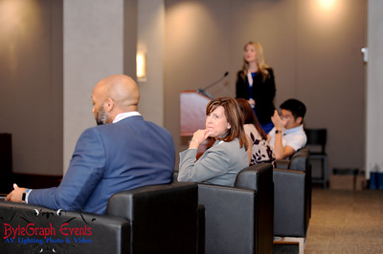
Our Success Stories . . .
In partnership with USPAACC National
and Wells Fargo Micro-Grant Funding Award
USPAACC-SE provides cutting-edge workshops on vital topics that assist Asian American businesses to grow and develop for bigger and better opportunities. We are proud to have the support of Wells Fargo and USPAACC to conduct these programs.
Delivering High-Caliber Capacity-Building Workshops

Slide 6
“Passionate Pillars for success”
Establish a dynamic working Board of Directors and Regional Advisors
Work collaboratively with USPAACC National
Recruit & retain Members (Corps) and Partners (AAEs)
Provide enriching Programs and Services that focus on the varying needs of all constituents
Forge partnerships and alliances with affinity groups to gain support

Slide 7
“Passionate Pillars for success”
Certify Asian American Businesses for contracting opportunities with Fortune 500 Corporations & government entities
Seek Market Penetration for sustainable growth by providing events and programs throughout the region
(i.e., FL, AL, TN, NC, SC)
Provide value-added sponsorships and a ROI to members and partners
Do more of what you’re good at – and do it with passion!
Always be getting smarter !

