Slide 1
Supplier Diversity
TIPS AND RECOMMENDATIONS FOR DIVERSE SUPPLIERS
ON NAVIGATING CORPORATE AMERICA

Slide 2
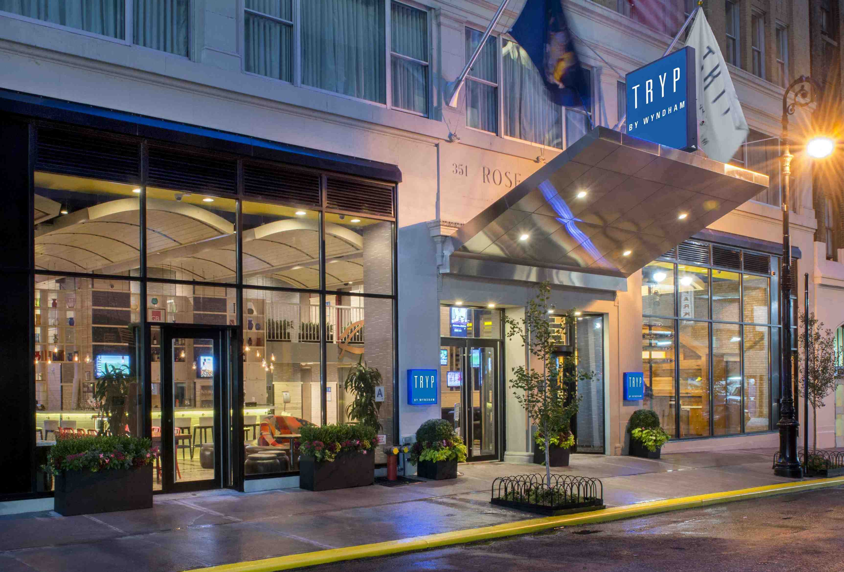
Wyndham Worldwide
One of the World’s Largest Hospitality Companies (NYSE:WYN)

Slide 3
Wyndham Worldwide Overview
Iconic brands and hotel choices in every category from upscale to economy, we offer the most lodging choices around the world.
Offers vacation options in more than 100 countries on six continents.
Over 200 vacation ownership resorts throughout the United States, Canada, Mexico, the Caribbean and the South Pacific.

Slide 4
Wyndham Worldwide
Leading Positions in Leisure industry
Business Segment
Major Brands Include
Market Position Worldwide
#1 Franchisor by Hotels
Hotel Group
#1 Timeshare Exchange and Rental Company
Destination Network
Vacation Ownership
#1 Timeshare Developer

Slide 5
Wyndham Worldwide Supplier Diversity
Is an integral part of the Wyndham corporate culture and a vital element to our success
Encompasses our key values of supporting our communities and improving our customers’ lives
Provides mentoring to those diverse suppliers who succeed in obtaining our business
Includes outreach activities
Supplier diversity is a proactive business process that seeks to provide equal access to all suppliers regardless of ethnicity, gender or sexual orientation for procurement opportunities

Slide 6
Pillars of Wyndham Supplier Diversity
Strong Top Management Commitment
Top Notch Strategic Sourcing Management
Proactive Involvement in all aspects of Supplier Diversity
Vibrant Supplier Diversity Council/ Champion Structure
Stakeholder Involvement and Relationship Building
Dynamic Diverse Business Community Outreach Program
Think Supplier Diversity Upfront and Early!

Slide 7
Agenda
NAVIGATING CORPORATE AMERICA AS A DIVERSE SUPPLIER
The basics…
Basics
One Page Profile
Value Add Proposition
Business Plan
Know your Capability
Patience!
Target Customers that are “Right Fit “ for you

Slide 8
NAVIGATING CORPORATE AMERICA AS A DIVERSE SUPPLIER
NAVIGATING CORPORATE AMERICA AS A DIVERSE SUPPLIER
…is a balancing act
Understand the corporate/procure-ment culture
Maintain Acceptable Credit History
Understand Corporate pain points and offer solutions
Find a mentor in Corporate America
Connect with your potential client at the right level
Relationships!
Relationships!
Relationships!
Seek Corporations with membership in advocacy groups
Innovate, Push the envelope and Dream Big
Consider Joint Venture or Strategic Alliance

Slide 9
Minimum Qualification For Potential Suppliers
Suppliers must be certified and demonstrate:
Industry Knowledge and Hospitality References are a Plus
Supplier offering relevance to WWC business solutions and strategy
Proven Financial Viability
Capacity
Geographic Bandwidth (Regional)
$1M Minimum Revenue
Technical Competence
Innovative and Solutions Oriented
Experience
3 Year Business History
Value Add
Competitive Pricing and Cost Saving Solutions
Quality Assurance
On Time Delivery

Slide 10
Potential Business Opportunities for Diverse Suppliers
Security Services
Energy Management
Waste oil Removal
Vent Hood Cleaning
Parking Technology
MRO Manufacturers
Deep Cleaning Companies
General Construction
Landscaping and Snow Removal
Fabrics and Artwork
Upholstered Seating
Carpet Manufacturers
Case Goods Manufacturers
Windows Treatments

Slide 11
Emerging Business Opportunities for Diverse Suppliers
Some of our Successful Diverse Suppliers
Operating supplies and equipment
Terry, Linen & Top of bed
Information Technology
Information Technology
Operating supplies and equipment
Housewares, Kitchenware
Cups, Memo pads, Laundry bags
Marketing
Information Technology
Operating supplies and equipment
Legal
Printing

Slide 12
Diverse Business Community Outreach
Diverse Business Community Outreach
Diverse Business Community Outreach
NMSDC
National Minority Supplier Development Council
NY/NJ Florida, Indiana & NW
Minority Supplier Development Council
Auxiliary Relationships
USHCC
United States Hispanic Chamber of Commerce
Morris County & Metro Orlando Hispanic Chambers
NGLCC
National Gay & Lesbian Chamber of Commerce
Local Chambers
Hispanic Association for Corporate Responsibility
AACC
African American Chamber of Commerce
New Jersey & Central Florida
Latina Style
USPAACC
United States Pan Asian American Chamber of Commerce
DiversityInc
NAVOBA
National Veteran-Owned Business Association
WEConnect International
Connecting Women Enterprises with Market Opportunity
National Association of Black Hotel Owners, Operators and Developers
NWBOC
National Women Business Owners Corporation
International Minority Supplier Development
MSD China & MSD UK
Latino Hotel Association
WBENC
Women Business Enterprises National Council
WPEO-NY
WBDC-FL
WBEC-PA/DE/NJ
NHBG
National Hispanic Business Group

Slide 13
Wyndham Worldwide Supplier Diversity
SUPPLIER REGISTRATION DETAILS
Suppliers that meet all the minimum qualifications and wish to become a Wyndham supplier should visit our
Supplier Registration Website:
suppliers.wyndhamworldwide.com

