Slide 2
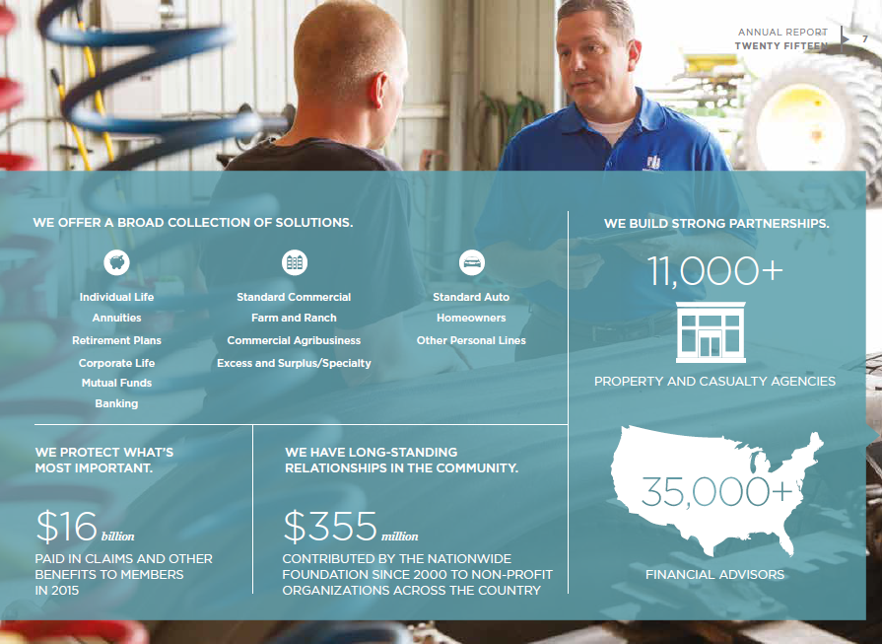
WE OFFER A BROAD COLLECTION OF SOLUTIONS.
WE BUILD STRONG PARTNERSHIPS.
11,000+
Individual Life Annuities
Standard Commercial Farm and Ranch
Standard Auto Homeowners
Retirement Plans
Commercial Agribusiness
Other Personal Lines
Corporate Life Mutual Funds Banking
Excess and Surplus/Specialty
PROPERTY AND CASUALTY AGENCIES
WE PROTECT WHAT’S MOST IMPORTANT.
WE HAVE LONG-STANDING RELATIONSHIPS IN THE COMMUNITY.
$355million
CONTRIBUTED BY THE NATIONWIDE FOUNDATION SINCE 2000 TO NON-PROFIT ORGANIZATIONS ACROSS THE COUNTRY
FINANCIAL ADVISORS

Slide 3
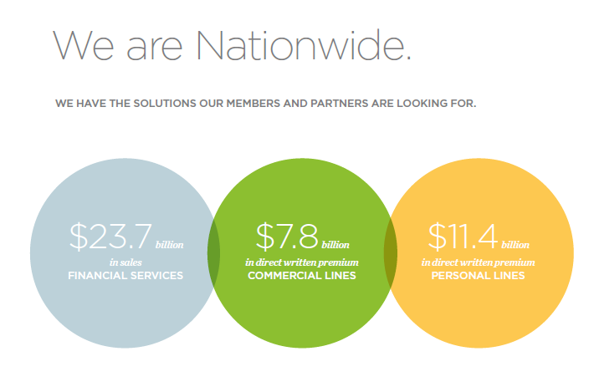
$23.7billion in sales
FINANCIAL SERVICES
$7.8billion in direct written premium COMMERCIAL LINES
$11.4billion in direct written premium PERSONAL LINES

Slide 6
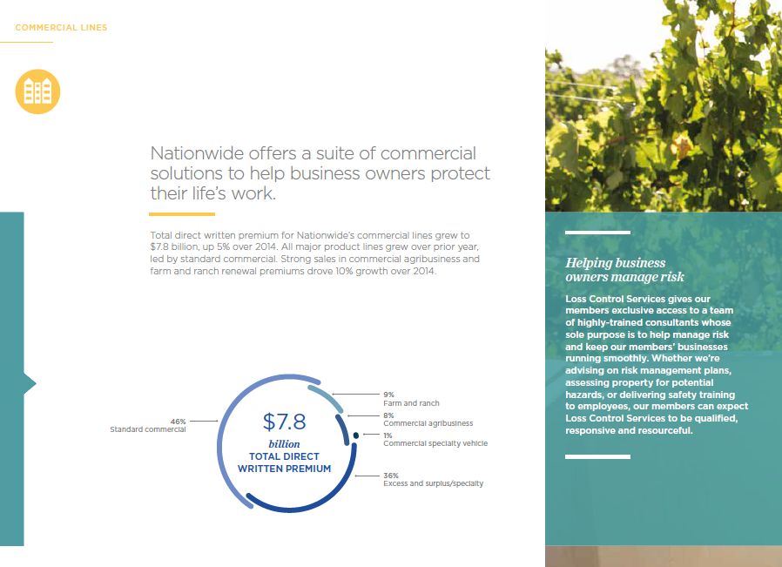

Slide 10
Grow opportunity
Facilitate lead generation opportunities
Competitive advantage
Leverage innovation, industry knowledge and unique abilities
Partnership strategy
Power of the community
Support the communities we serve
Awareness, Affinity and Action
Driving Value Through
Supplier Diversity

Slide 11
Doing Business with Nationwide
Get your certification and keep it current – Many large corporations have supplier diversity programs geared towards strategic and subcontracting opportunities that target diverse suppliers…if possible avoid self-classification.
Join 3rd party
national or regional organizations – it helps with networking.
Research before you approach Nationwide – Study our website, learn our products and services.
Don’t expect business right away – it can take years to land your first contract…but it can be done.
Explore Tier 2 relationships with our Tier 1 suppliers – Consider partnering with Primes to get started.
Differentiate your company from your competitors – in your pitch/capability statement tell us what sets you apart, what makes your products/services better than competitors.
Register on Supplier Connections website. Supplier Connections helps 31 Fortune 500 Buying Members find the right businesses for their supply chains. By being able to view a comprehensive profile on each small business, buyers are able to make sourcing decisions easier, smarter and faster.
(https://www.supplier-connection.net/
SupplierConnection/index.html)
Don’t overpromise – Never promise what you cannot do.

Slide 12
Sourcing Category | Description
Aviation | Aircraft, fuel, etc.
Benefits | Medical, Vision, Dental, Accident insurance, Life, Legal & Travel insurance, Retirement, Associate Recognition & Perks, Disability insurance, etc.
Collection Services | Agency & Premium Collections, Collection Recovery & Subrogation
Data | Banking, Claims, Investments, Mortgage, Mutual Funds, Retirement Plans, Underwriting, etc.
Document Management | Archival
Facilities | Building Operations, Construction, Food & Beverage, Furniture, Furnishing, & Fixtures, Landscaping & Outdoor Services, Lease Administration Management, Maintenance, Safety & Security, Utilities, etc.
Financial Services | Banking Services, Mortgage Services, Payment Services, Associate Assistance Plans, Health Assessment, Wellness Programs
Insurance & Reinsurance | Insurance Brokers, Licensing, Reinsurance Brokers
Investigation Services | Fraud Detectors, Independent Adjusters, TPAS, Investigators, Medical Canvassing
Legal Services | Arbitration/Mediation, Class Action Settlements, Compliance, Court Reporting, Legal Bill Review, Legal Research, Structured Settlement
Mail Services | End to End Mail Services
Marketing, Communication, & Print | Advertising, Communications, Data Management, Market Research, Print, Sales, Sponsorship, etc.
Medical | Bill Review, Case Management, Independent Medical Exams/Review, Labs, Medical Equipment, Records & Services, Parameds, Pharmacy, Pharmacy Intervention
Member Services | Alternative Living Expenses, Content, Contractors, Estimating, Glass, Rental, Salvage, Tow/RSA, Parts, etc
Office Supplies | End to End Solutions
Professional Services | Consulting, Contingent Labor, Outsourcing, Transcription, Translation Services
Recruiting | Outplacement, Pre-employment
Reports | Court Records, Motor Vehicle Reports, Public Reports, Skip Trace
Technology | Hardware, Software, Storage, Telecommunications
Training | Delivery, Development, Delivery & Development
Travel | Expense Reimbursement, Group Travel, Transient Travel
Underwriting Services | Boards, Bureaus, & State Required, Comparative Raters, Forms, Rules, Loss Cost, Identity Theft, Telematics

