Slide 1
Immense Opportunity with High Risk
Chief Information Security Officer
“It’s about the only executive-level job I can think of where you are 100 percent accountable for the failures to come, even though it’s a guarantee that they will happen at some point. It’s like playing chess with a blindfold on – you can’t win”
Forrester Research

Slide 2
Cybersecurity Unemployment is 0%
There are 1 Million unfilled Cybersecurity jobs globally today!
By 2021 there will be 3.5 million unfilled globally!
Cybersecurity Ventures Report

Slide 3
Cybersecurity Spending is on the rise
$96 Billion in 2018
Gartner

Slide 4
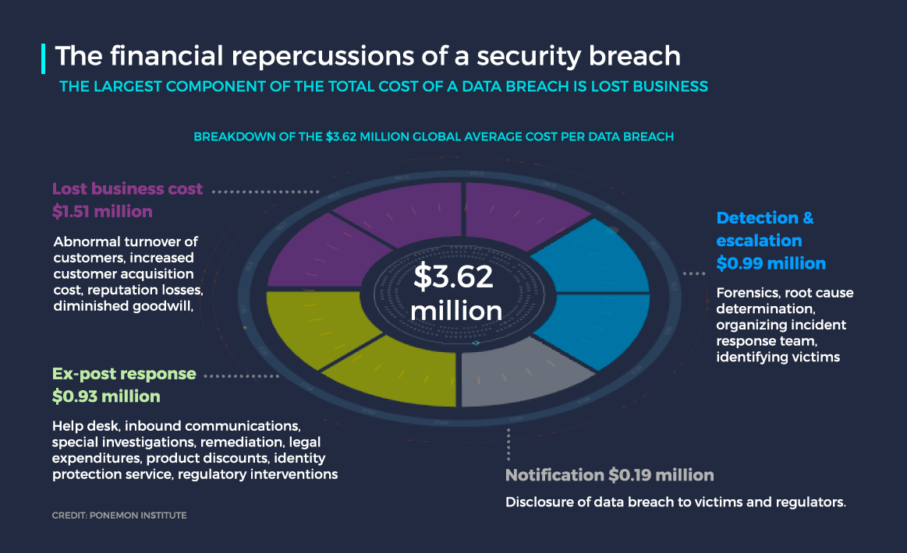

Slide 5
Focus
Verticals
Segments
Specialty

Slide 6
Capitalize on
Transferrable Skills

Slide 7
Diversity
is Essential

Slide 8
Trust

